Slide 1
Real-Time Anomaly Detection System for Highway Traffic
Milos Kotlar
(kotlar.milos@gmail.com)

Slide 2
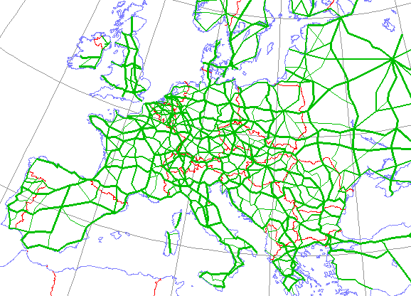
Problem
Criminal activities in highway traffic data could be considered as anomalies:
Smuggling
Trafficking
Kidnapping
Terroristic attacks
Protests
etc
Approach: Simulate highway traffic flow
Goal: Detect Anomalies

Slide 3
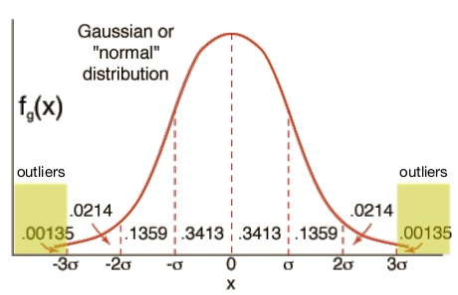
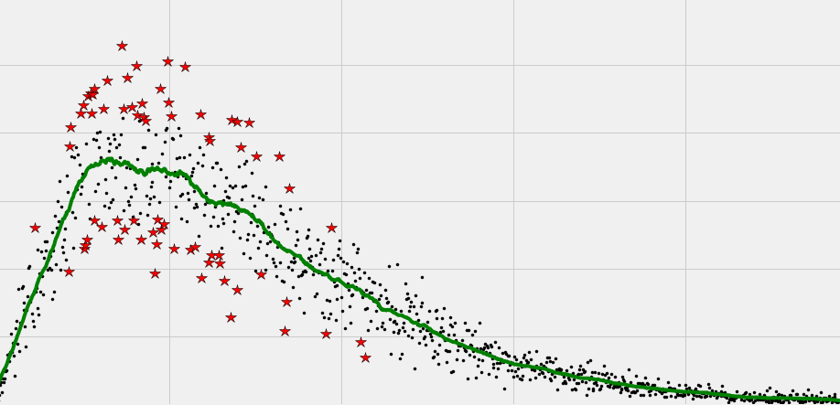
Anomalies
Univariate anomalies - extreme values of a single feature, where values deviate from the rest of distribution
Multivariate anomalies - multiple features combined together deviates from the rest of distribution

Slide 4
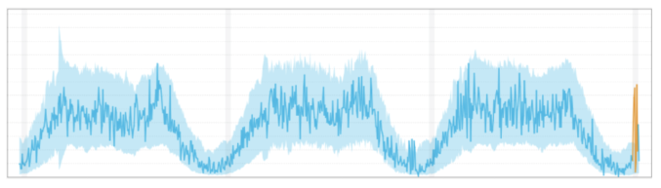
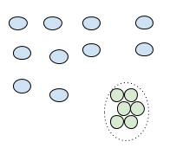
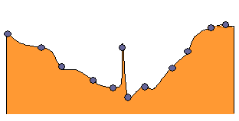
Anomalies
Point anomalies - deviate largely from the rest of the data points
Contextual anomalies – “Is the temperature normal today?”
Collective anomalies - data points included in forming the collection may not be anomalies when considered individually

Slide 5
Anomalous Patterns
Smuggling/Trafficking - Trucks or buses heading out of country using alternative routes
Kidnapping/Robbery - Luxury cars speeding with no tendency to leave the country
Car Hijacking - Luxury cars speeding with tendency to leave the country
Protests – Tolls with capacity higher than usual
Terroristic Attack – A group of suspicious vehicles heading to the same direction
Criminal Organizations - A group of suspicious vehicles heading in different directions
Missing Vehicles - A vehicle that does not have an exit record on a particular toll
Suspicious Activity – A suspicious vehicle that drives the same route too often
Novel Activity for a Single Vehicle
Novel Activity for a Group of Vehicles

Slide 6
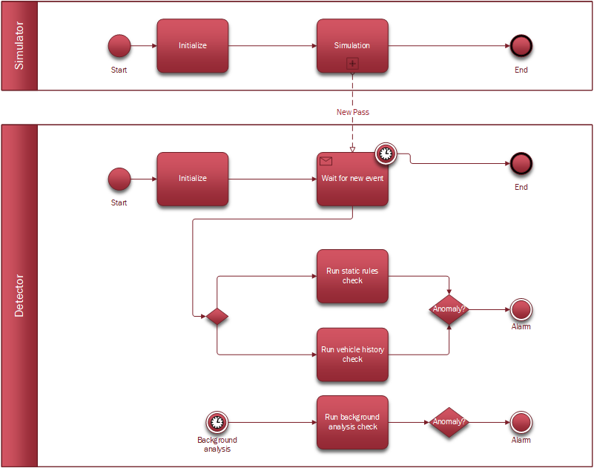
Proposed System

Slide 7
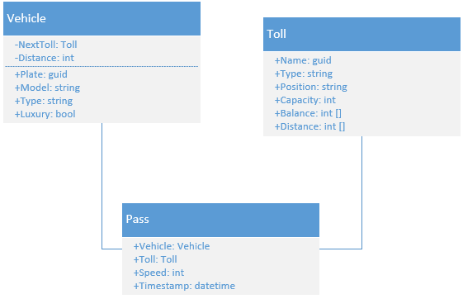
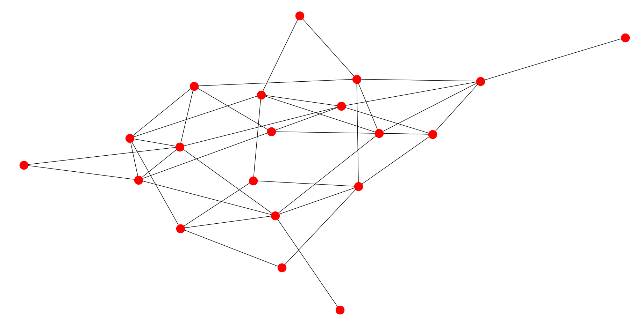
Data Model
An example of highway network graph

Slide 8
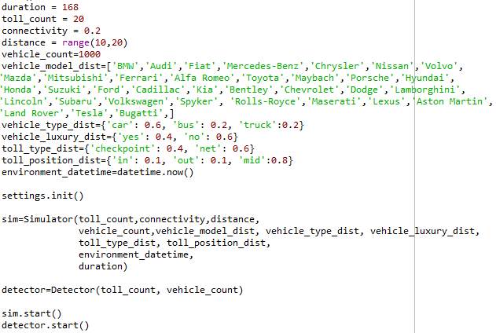
Implementation Details
Simulator
Environmental details and properties of simulation
When a vehicle passes a toll, new event is capture
Detector
Static rules check
Vehicle history check
Background analysis

Slide 9
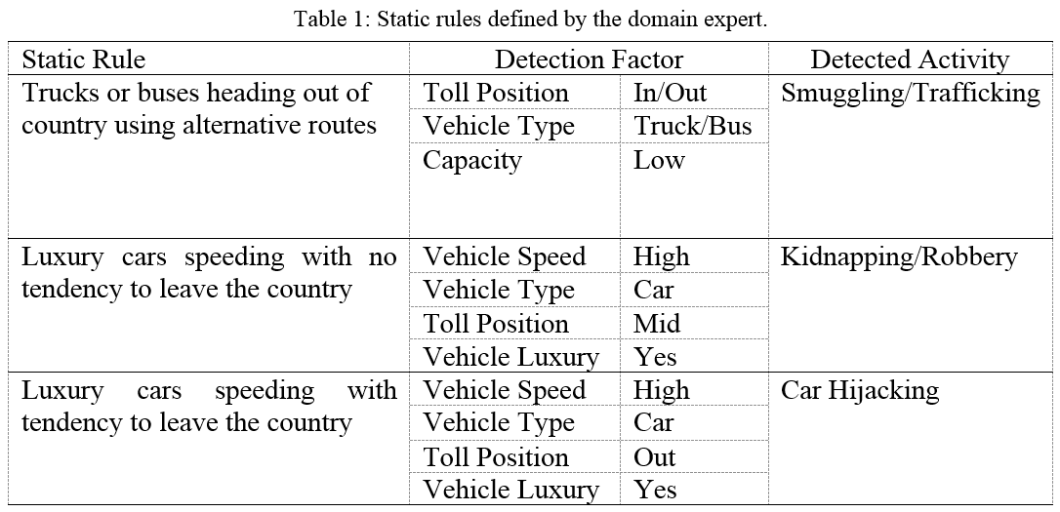
Static Rules

Slide 10
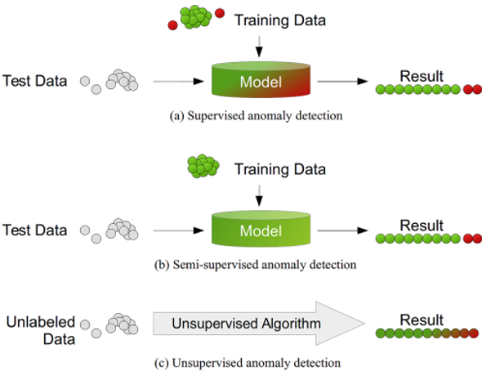
Machine Learning Anomaly Detection

Slide 11
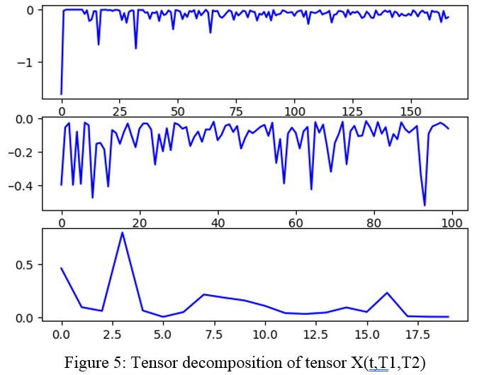
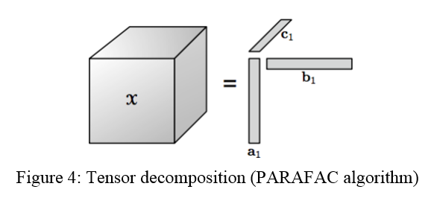
Tensor Decomposition
Entry of the tensor presents whether a vehicle passed T1 coming from T2 in hour t

Slide 12
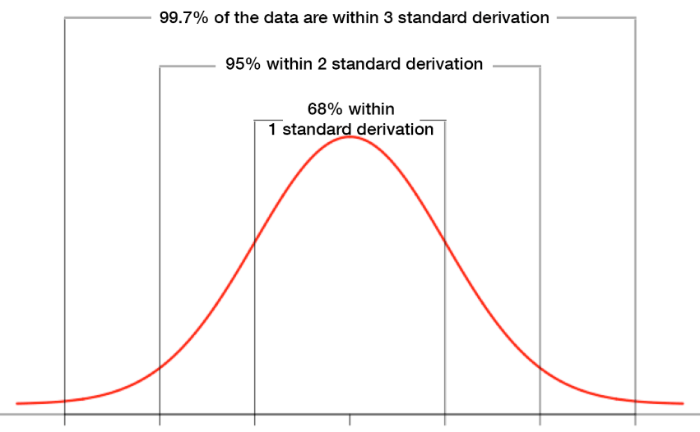
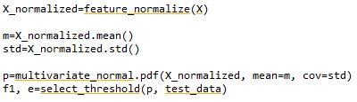
Multivariate Gaussian Distribution
Model is fitted to data distribution
Mean and variance is estimated for each feature
Calculate probability of each example, how similar it is to data distribution

Slide 13
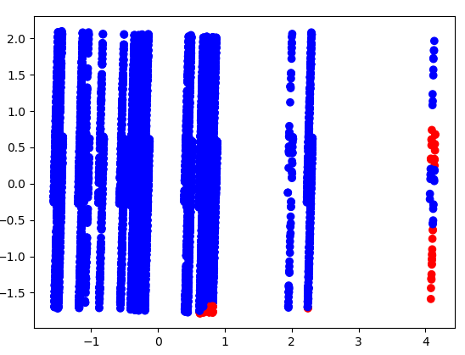
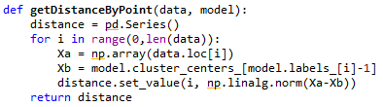
Clustering
K-Means
Data points that are far from the cluster could be considered as anomalous data points

Slide 14
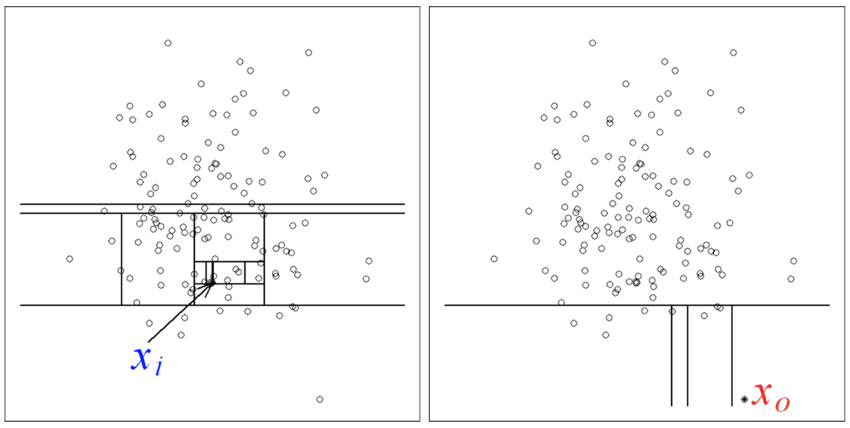
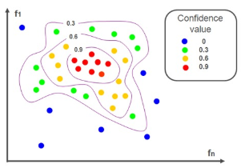
Classification
One SVM - classifier that can predict only one class, normal class without anomalies
Isolation Forest – classifier measures path length from root to the predicted class; if it is too short, the data point is far from data distribution

Slide 15
Available Datasets & Source Code
https://nswtollroaddata.com/
https://github.com/geohacker/toll-plazas-india
https://catalog.data.gov/dataset/nys-thruway-origin-and-destination-points-for-all-vehicles-15-minute-intervals-latest-full
http://networkrepository.com/road.php
https://www.kaggle.com/CooperUnion/cardataset
Github Repo: https://github.com/kotlarmilos/anomalydetection

Slide 16
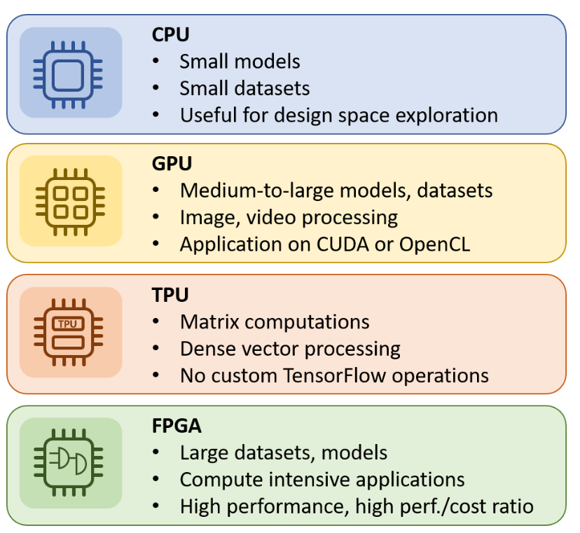
Performance Evaluation
Methods:
Clustering (k-means)
Classification (IsolationForest/OneClassSVM)
Multivariate Gauss
Tensor Decomposition
Architectures:
CPU
GPU
FPGA
ASIC

Slide 17
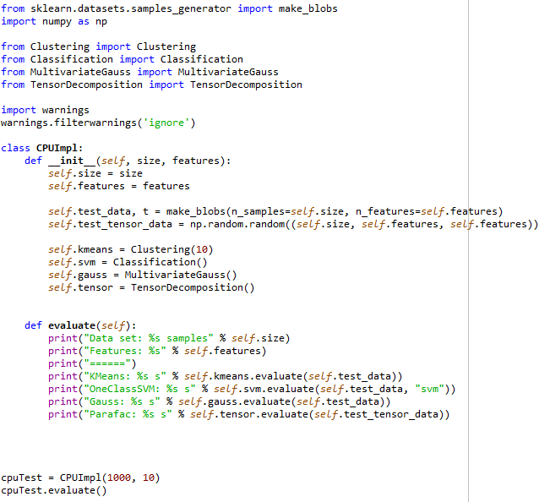
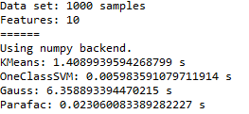
CPU Implementations
Results:
Source:
https://github.com/kotlarmilos/anomalydetection

Slide 18
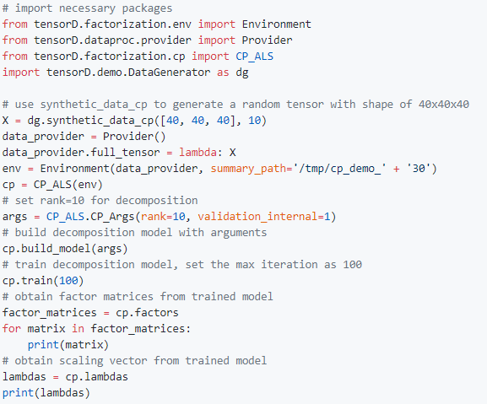
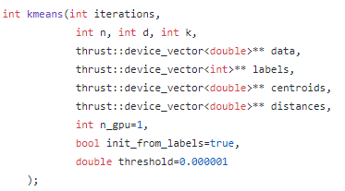
GPU Implementations
Clustering: https://github.com/NVIDIA/kmeans
Classification: https://github.com/Xtra-Computing/thundersvm
Tensor Decomposition: https://github.com/Large-Scale-Tensor-Decomposition/tensorD

Slide 19
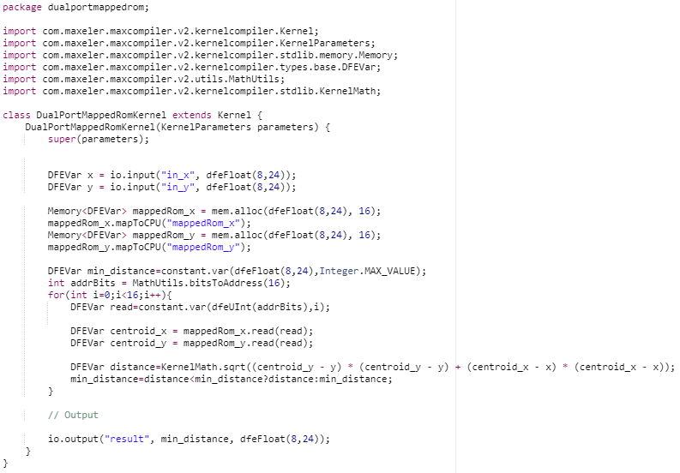
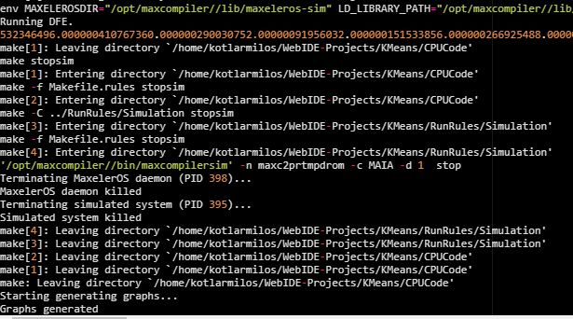
FPGA Implementations
Sources:
https://github.com/kotlarmilos/anomalydetection
https://github.com/maxeler/ Classification

Slide 20
ASIC Implementations
In open literature there are papers related to ASIC accelerators with optimized memory use and the use of lower precision arithmetic:
"Google boosts machine learning with its Tensor Processing Unit, " www.serverwatch.com, 2016.
"Chip could bring deep learning to mobile devices, " www.sciencedaily.com, 2016.
"Deep Learning with Limited Numerical Precision, " International Conference on Machine Learning, 2015.
R. Mohammad, O. Vicente, R. Joseph, and F. Ali "XNOR-Net: ImageNet Classification Using Binary Convolutional Neural Networks, " arXiv:1603.05279.

Slide 21
Problem
We immediately found that different architectural approaches do not allow for a full direct comparison of performance, power consumption, latency, and data processing bandwidth
State-of-the-art hardware
Optimization constructs
https://inaccel.com/cpu-gpu-fpga-or-tpu-which-one-to-choose-for-my-machine-learning-training/

Slide 22
References
https://www.aaai.org/Papers/AAAI/2002/AAAI02-034.pdf
http://stanford.edu/~rezab/classes/cme323/S15/notes/lec14.pdf
http://www.cleveralgorithms.com/nature-inspired/advanced/racing_algorithms.html
http://www.cmap.polytechnique.fr/~nikolaus.hansen/benchmarking-and-experimentation-gecco17-slides.pdf
https://github.com/NVIDIA/kmeans
https://github.com/Xtra-Computing/thundersvm
https://github.com/Large-Scale-Tensor-Decomposition/tensorD
http://rvlasveld.github.io/blog/2013/07/12/introduction-to-one-class-support-vector-machines/
https://towardsdatascience.com/support-vector-machine-introduction-to-machine-learning-algorithms-934a444fca47
https://quantdare.com/isolation-forest-algorithm/
https://endymecy.gitbooks.io/spark-ml-source-analysis/content/%E6%8E%A8%E8%8D%90/papers/Large-scale%20Parallel%20Collaborative%20Filtering%20the%20Netflix%20Prize.pdf

